Slide 1
Markov Random Fields
James Leiner

Slide 2

Quick recap on graph theory
An (undirected) graph is an ordered pair of G = (V,E) comprising:
V a set of vertices
E a set of edges:
A directed graph keeps the same structure as above but also induces a direction for each edge based on the ordering
(x,y) denotes that x is the parent and y is the child node
(y,x) denotes that y is the parent and x is the child node
Undirected Graph
X
Y
Z
Directed Graph
X
Y
Z

Slide 3
Big picture—DGMs and UGM
Let’s assume each node on a graph takes on values probabilistically. How do we assign a joint probability distribution to the entire graph?
DGMs are simpler because the induced ordering allows us to define the joint distributions by assuming a relationship between child and parent nodes and using chain rule.
For instance:
Natural way to represent certain types of data—for instance, time series/econometric. See AR models.
UGMs assume no ordering between nodes
More natural for image data or anything spatiotemporal
Downside is that it is harder to express the dependence relationship between different nodes
Some distributions can be modeled either as an DGM or UGM. These resulting graphs are called chordal. However, there are certain distributions that can only be modeled as one or the other.

Slide 4

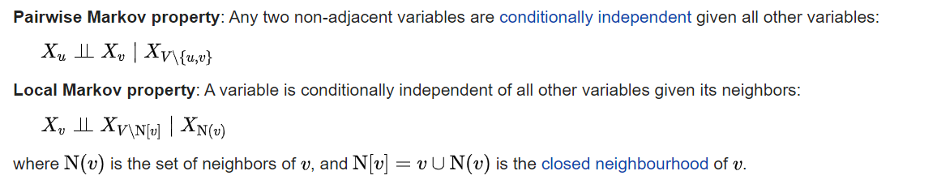

Definition of MRFs / UGMs
An undirected graph G = (V,E) and a set of random variables X = ${\{X_{j}\}}_{j∈V}$ that is indexed by V is a UGM if it satisfies the global Markov property:
Given two sets of nodes A and B. If every path from node A and B passes through S then:
The global Markov property implies two less strong statements (screengrab from Wikipedia):
Intuitively—a graph can be broken up into ‘chunks’ that are conditionally independent from each other—making the probability distribution easier to work with

Slide 5
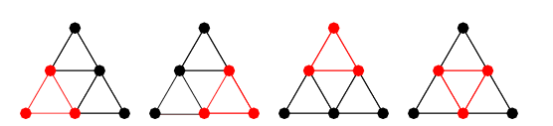
Cliques, maximal cliques (i.e. ‘chunks’)
A clique of an undirected graph is a subset of the vertices such that any two distinct vertices are adjacent (i.e. they share an edge)
A maximal clique is a clique that cannot be extended by including additional vertices
Example—each of the red triangles below is a maximal clique of the larger triangle:
Source for image: http://mathworld.wolfram.com/Clique.html

Slide 6
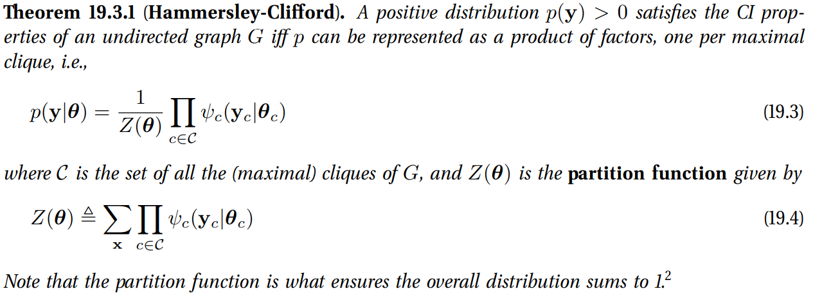
Hammersley-Clifford theorem
Key result—we can describe the probability distribution of any UGM simply by considering its maximal cliques separately.

Slide 7



Hammersley-Clifford thereom (cont.)
Suppose we define the log potential function as a linear function of parameters:
This allows us to define the equation more compactly using logarithms:
An important special case consists of maximal cliques which consist only of the graph’s edges. This is called the pairwise MRF:

Slide 8
Simple Example
Consider the arrangement of three electrons with two edges, as shown below. Each can take on positive or negative spin, represented by {+1,-1}
The potential function is defined as
We can then explicitly calculate the probability of each state occurring for b = 0, J = 1
A
B
C
A | B | C | ψ | Z | Probability
1 | 1 | 1 | 7.39 | 19.05 | 38.79%
1 | 1 | -1 | 1.00 | 19.05 | 5.25%
1 | -1 | 1 | 0.14 | 19.05 | 0.71%
1 | -1 | -1 | 1.00 | 19.05 | 5.25%
-1 | 1 | 1 | 1.00 | 19.05 | 5.25%
-1 | 1 | -1 | 0.14 | 19.05 | 0.71%
-1 | -1 | 1 | 1.00 | 19.05 | 5.25%
-1 | -1 | -1 | 7.39 | 19.05 | 38.79%

Slide 9
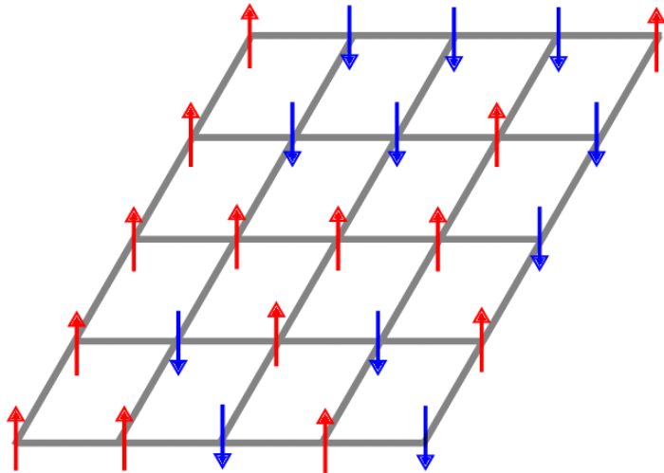

Ising Model
If we generalize the above to an n-dimensional lattice, we have the Ising model. Here, the potential function is defined for each edge (i.e. pairs of adjacent electrons):
Typically, a constant term J =w_{st} is assumed.
Negative values for J are indicative of “anti-ferromagnets”—i.e. opposite signed electrons are attracted to each other
Positive values for J are indicative of “ferro-magnets”—i.e. like charges attract like
The b vector is typically termed the bias. Intuitively, can be thought of as some outside disturbance that wants to “force” electrons in a certain direction regardless of adjacent neighbors

Slide 10
Sampling procedures for Ising model
In theory, calculating Z(J) requires 2^{D} different states. If D is large, we can use some sampling algorithms.
Most common ones to use:
Metropolis-Hastings algorithm
Gibbs sampling

Slide 11
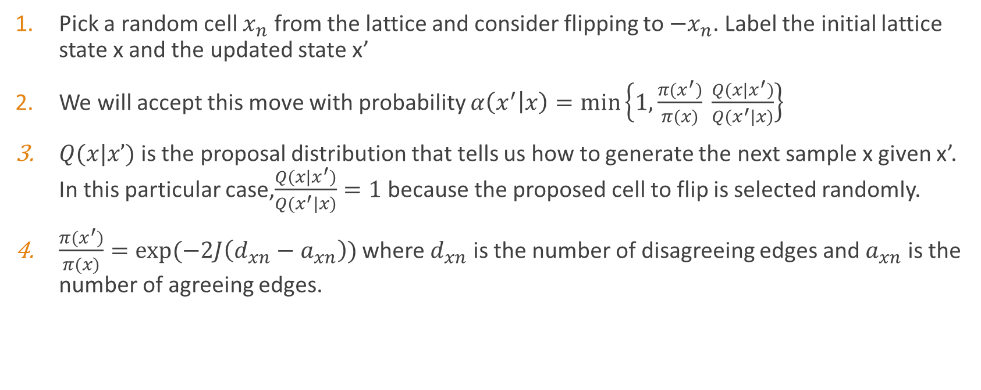
Metropolis-Hastings sampler
Pick a random cell $x_{n}$ from the lattice and consider flipping to ${−x}_{n}$. Label the initial lattice state x and the updated state x’
We will accept this move with probability $α\left(x^{′} | x\right)=min\left\{1, \frac{π(x^{′})}{π(x)} \frac{Q(x|x^{′})}{Q(x^{′}|x)}\right\}⁡$
$Q(x|x’)$is the proposal distribution that tells us how to generate the next sample x given x’. In this particular case,$\frac{Q(x|x^{′})}{Q(x^{′}|x)}=1$ because the proposed cell to flip is selected randomly.
$\frac{π(x^{′})}{π(x)}=exp⁡(−2J\left(d_{xn}−a_{xn}\right))$ where $d_{xn}$ is the number of disagreeing edges and $a_{xn}$ is the number of agreeing edges.

Slide 12
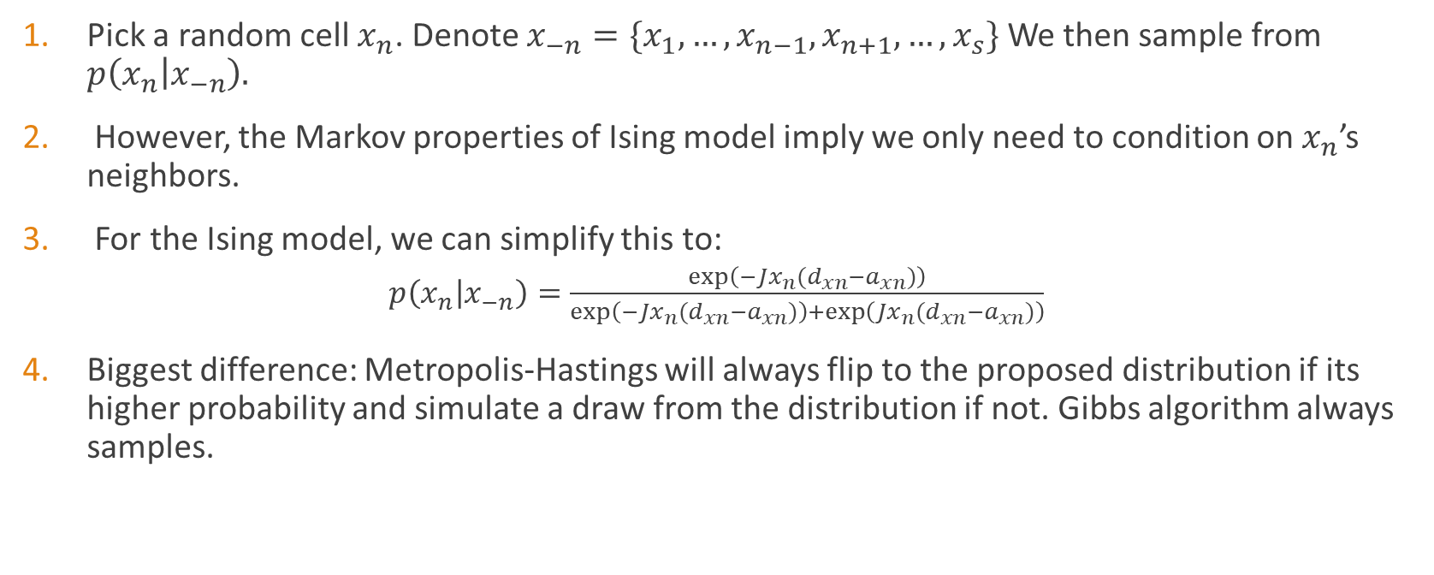
Gibbs sampler
Pick a random cell $x_{n}$. Denote $x_{−n}=\{x_{1},…,x_{n−1},x_{n+1},…,x_{s}\}$We then sample from $p\left(x_{n} | x_{−n}\right).$
However, the Markov properties of Ising model imply we only need to condition on $x_{n}$’s neighbors.
For the Ising model, we can simplify this to:
$p\left(x_{n} | x_{−n}\right)=\frac{exp\left(−Jx_{n}(d_{xn}−a_{xn})\right)}{exp\left(−Jx_{n}(d_{xn}−a_{xn})\right)+exp\left(Jx_{n}(d_{xn}−a_{xn})\right)}$
Biggest difference: Metropolis-Hastings will always flip to the proposed distribution if its higher probability and simulate a draw from the distribution if not. Gibbs algorithm always samples.

Slide 13

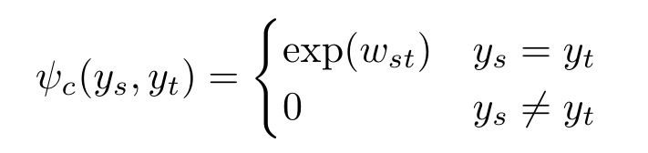

Potts model
The Potts model generalizes the Ising model to multiple discrete states.
Define the potential function as:
This can be written in log form:
Now require computation of K^{D} to calculate the normalization factor Z(J). Sampling options include:
Swendsen–Wang sampling
Nested Sampling
See http://mlg.eng.cam.ac.uk/zoubin/papers/nips05nested.pdf

Slide 14
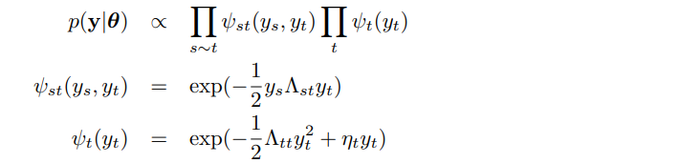

Gaussian MRFs
Gaussian MRFs are pairwise MRFs with the following form:
Essentially this reduces to a multivariate Gaussian with the form

Slide 15
Applications
Image denoising using Ising or Potts model (Jupyter notebook example)
Gaussian MRFs often used to model vector autoregressions
Hopfield networks are a special of Ising model used for associative memory applications

